Slide 1
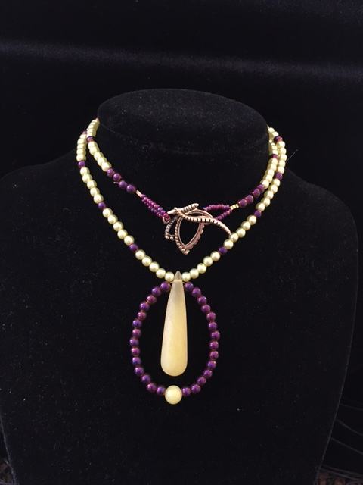
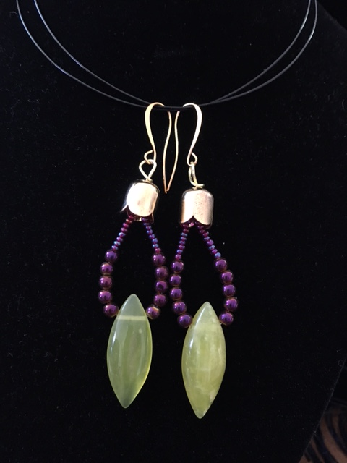
Lime green citrine combines with iridescent purple beads and lime green pearls. Clasp is a butterfly.
$45
Matching earrings- $20
For Sale

Slide 2
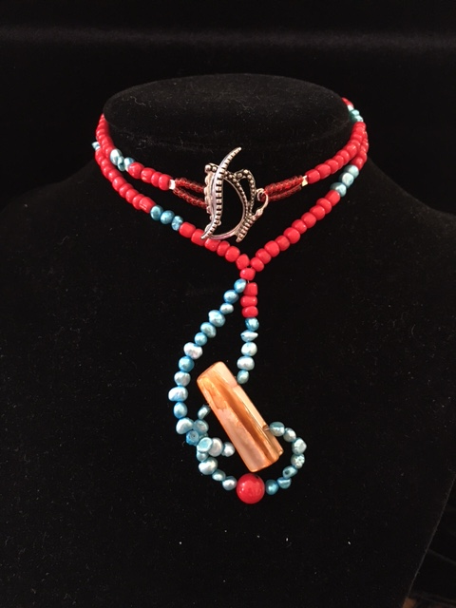
Gold pearl bead is wrapped in read coral and aqua peals. The clasp is a butterfly.
$45
Matching earrings- $20
For Sale

Slide 3
Copper earrings- $15
Silver wire earrings with copper beads- $15
Brass earrings- $15
For Sale

Slide 4
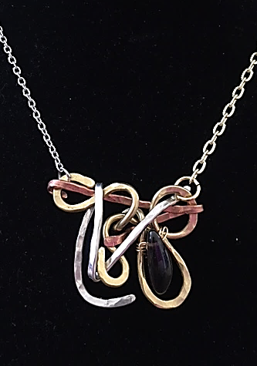
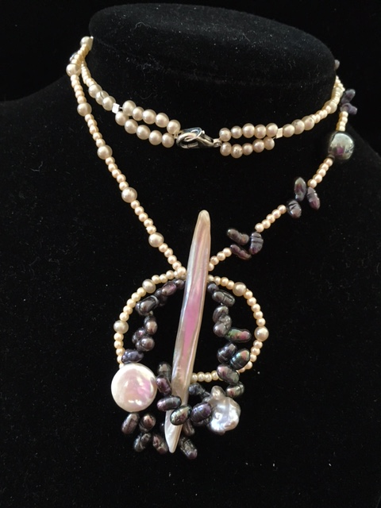
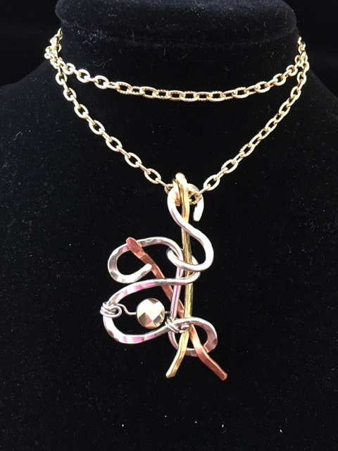
Smoke Quartz- replaces vulnerability with courage
Pyrite- kick-starter- increases positive energy
Pearls- promotes self care and emotional healing
For Sale
For Sale

Slide 5
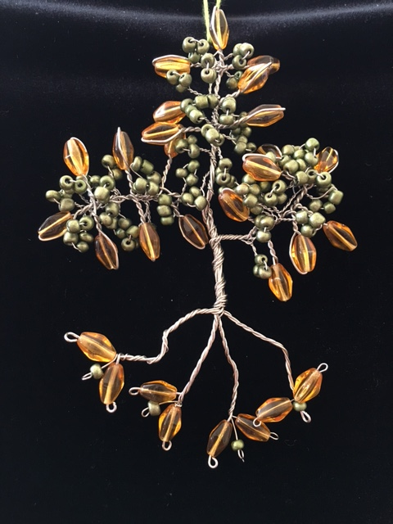
Tree of Life sun catcher for the window or decoration for a wall. $ 25
For Sale

Slide 6
Jewelry Class
Brass barrel clasps combine with gold beads to form this repurposed necklace.
Earrings to match: Class Fee - $30
Length of class: 1 ½ hours

Slide 7
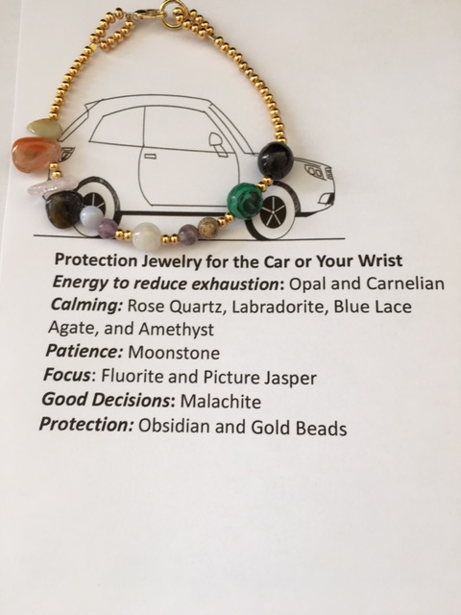
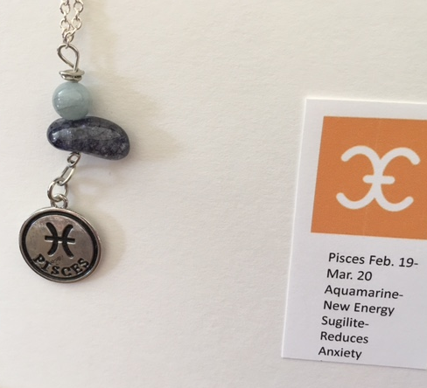
Length of class: 1 hour
Zodiac belt loop charm or infinity scarf charm.
When you sign up for the class, we need to know your zodiac sign.
Class fee- $25
Class fee- $25
Length of class: 1 hour
Jewelry Class-

Slide 8
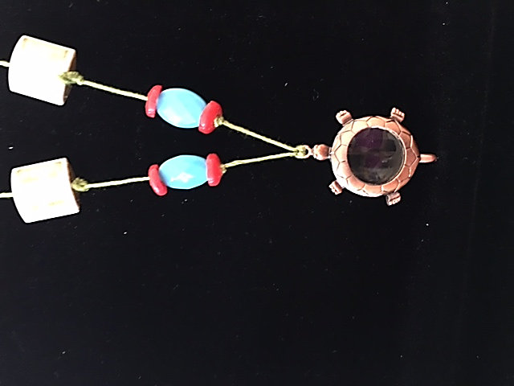
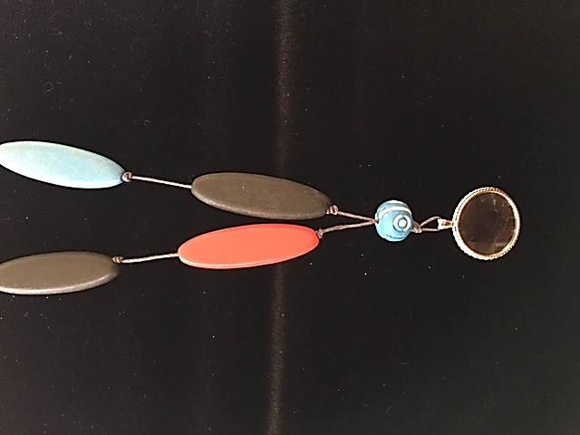
Jewelry Class
Magnifying Glass necklace Class fee $25
Length of class: 1 hour

Slide 9
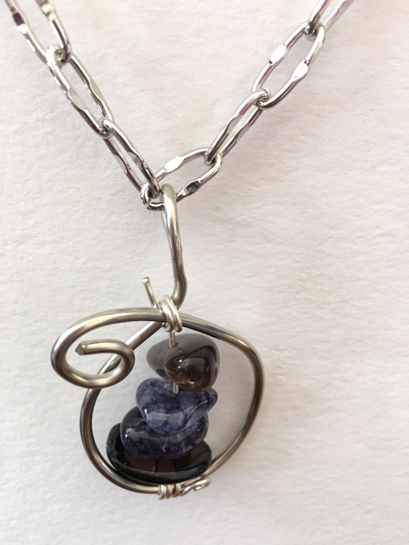
Trust Me: Smokey Quarts- increases courage and self confidence Sugilite- cleanses the body.
Ah- Sleep: Amethyst, Labradorite, Rose Quartz and Smokey Quartz brings a good night sleep.
Change is Good: Rainbow crystal- amplifies energy and clears pathway for change.
Gemstones have healing properties and each necklaces is different regarding what it amplifies. The following 2 slides show possibilities one can make in a jewelry class.

Slide 10
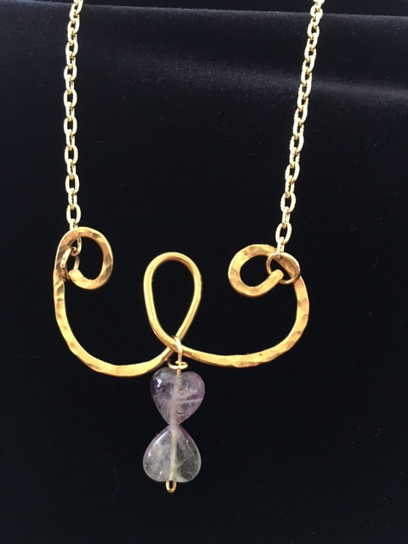
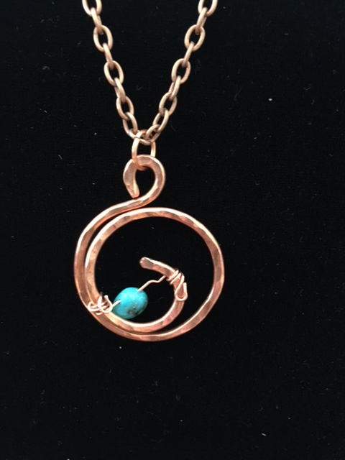
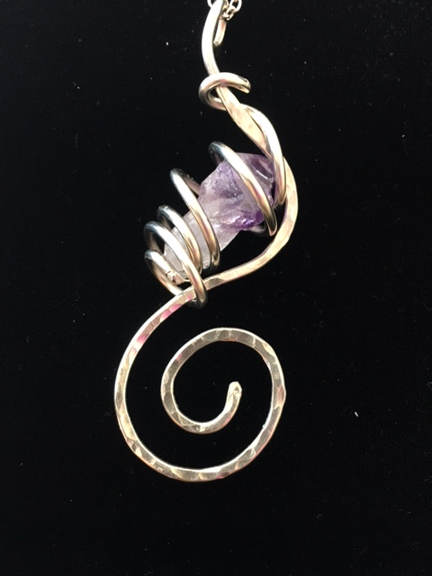
I-Can-Do-It Attitude- fluorite amplifies this.
Openness: Turquoise amplifies positive energy-
Relaxation: Amethysts amplifies calmness.
Jewelry Class
Class Fee: $30- Length of class: 1 ½ hours

Slide 11
Jewelry kits Georocks – You rock

